Slide 1

Super resolution using CNN
Richard Hemphill
ECE5268
Dr. Anagnostopoulos
Individual Class Project Topic

Slide 2
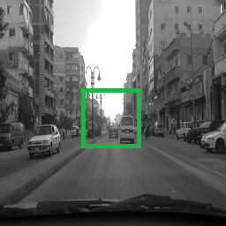
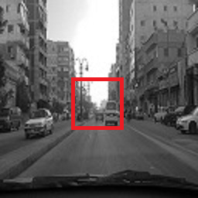
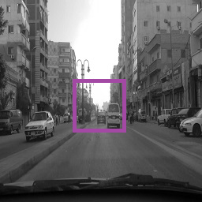
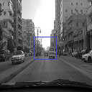



Description
Using small-sized grayscale images, construct a CNN-based architecture that will downscale (magnify) the images by a factor of 2.
Original Image
Reduced Image
Magnified Image
Super Resolution

Slide 3
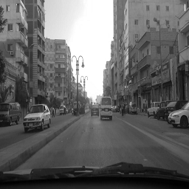
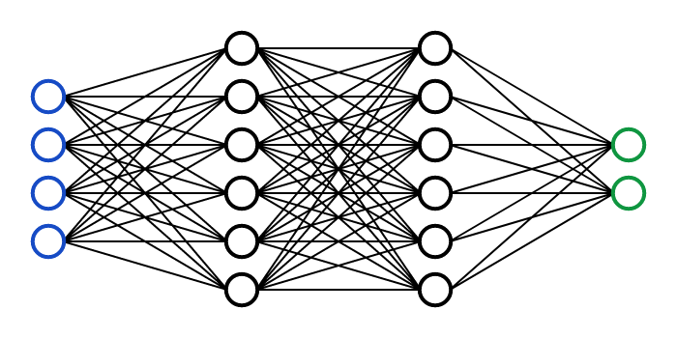
Goal
The goal of the project is to construct Python code to import and extract a dataset, take shrunken images with the original and train a CNN (Convolutional Neural Network) to magnify and subsequently enhance an image back to the original.
Image Dataset
error
reduce
Neural Network
-
+

Slide 4
Architecture
The model: creates feature maps of the low-resolution image, increases the dimensionality (i.e. number of nodes in a layer), then reconstructs the expected high-resolution image.
Feature Maps of Low-Resolution Image
Feature Maps of High-Resolution Image
Low Resolution Image
High Resolution Image
Patch Extraction and Representation
Non-Linear Mapping
Reconstruction

Slide 5
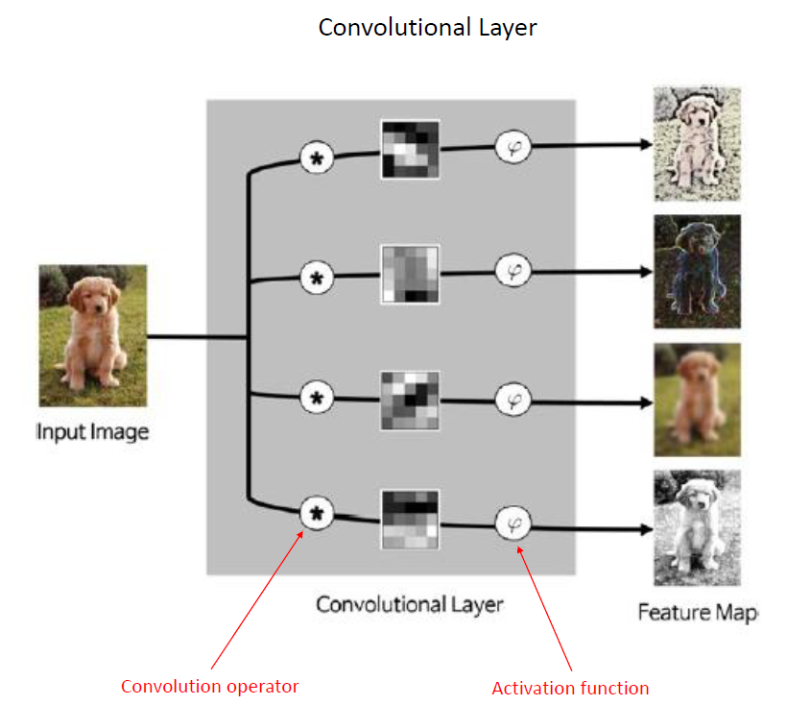
Convolutional Layer
The image is convolved with multiple kernels to produce a set of feature maps.

Slide 6
Parameters
The model parameters came from Image Super-Resolution Using Deep Convolutional Networks. The following are the design decisions if larger values were used.
Number of Kernels
marginally increase quality
drastically affect speed of training
Kernel Size
marginally richer structural information
drastically affect speed of training
Number of Layers
no apparent improvement in image quality
increases convergence time.

Slide 7
Patch Extraction and Representation
The low-resolution image is convolved with 64 9x9 kernels to produce 64 feature maps.
9 columns
9 rows
64 kernels
2048 neurons
32x32
64 images
32x32
32x32
32x32
*

Slide 8
Non-Linear Mapping
The low-resolution feature maps are convolved with 32 1x1 kernels to enhance the important features.
1 column
32 kernels
1 row
2048 neurons
32x32
32 images
1024 neurons
32x32
32x32
*

Slide 9
Reconstruction
The non-linear mapping features are convolved with 4 5x5 kernels to produce a patch-wise representation. Thus, generating the high-resolution image.
5 columns
5 rows
4 kernels
4096 neurons
1024 neurons
64x64
*

Slide 10
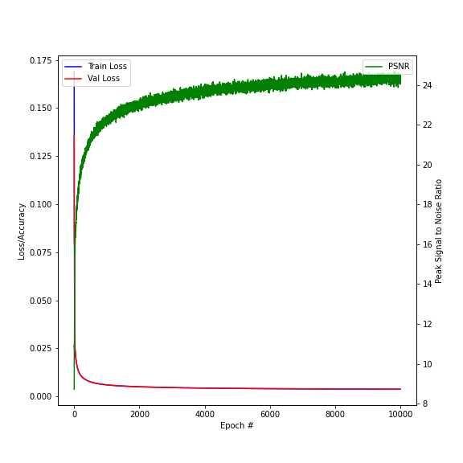
Training Metric
As the model is trained, the image quality improves.
The validation loss converges close to the training loss (i.e. no overfitting).
Training Time
GPU: NVIDIA GeForce GT 730
Epics: 10,000
Time: 13 hours 45 minutes

Slide 11

Training Samples
As the model gets train over epochs, the magnification become clearer and closer to the objective.
Objective

Slide 12
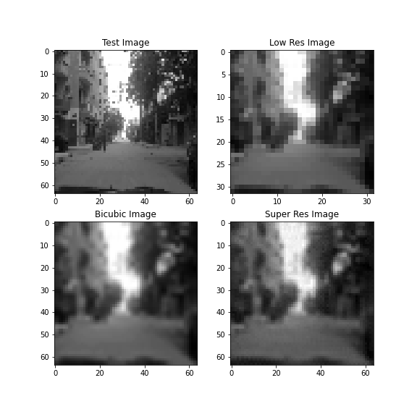
Test Result
Performing magnification via super resolution produced a slightly lower image quality than bicubic interpolation.
Average Test PSNR
Bicubic: 25.1
Super Resolution: 20.5

Slide 13
References
C. Dong, C. C. Loy, K. He and X. Tang, "Image Super-Resolution Using Deep Convolutional Networks," in IEEE Transactions on Pattern Analysis and Machine Intelligence, vol. 38, no. 2, pp. 295-307, 1 Feb. 2016, doi: 10.1109/TPAMI.2015.2439281.
Goose, Mr. “AlexOnly_Greyscale,” January 22, 2020. https://www.kaggle.com/spaceengineer1/alexonly-greyscale.
Long, Xingyu. “Image Super-Resolution Using an Efficient Sub-Pixel CNN,” 2020. https://keras.io/examples/vision/super_resolution_sub_pixel/.
Hemphill, Richard. “Richardhemphill/SuperResolution.” GitHub. Accessed April 11, 2021. https://github.com/richardhemphill/SuperResolution.
Daniel, Jeff. Medium. Accessed April 11, 2021. https://medium.com/@jeff.daniel77/accessing-the-kaggle-com-api-with-jupyter-notebook-on-windows-d6f330bc6953.

